Slide 1

18.404/6.840 Lecture 15
Last time:
- NTIME$\left(t\left(n\right)\right)$, NP
- P vs NP problem
- Dynamic Programming, $A\text{CFG}∈$ P
- Polynomial-time reducibility
Today:
- NP-completeness

Slide 2






Quick Review
Defn: $A$ is polynomial time reducible to $B$ ($A≤_{P}B$) if $A≤_{m}B$
by a reduction function that is computable in polynomial time.
Theorem: If $A≤_{P}B$ and $B∈$P then $A∈$ P.
$$A$$
$$f$$
$$B$$
$f$ is computable in polynomial time
NP = All languages where can verify membership quickly
P = All languages where can test membership quickly
P versus NP question: Does P = NP?
?
P
NP
P = NP
$SAT=\left\{〈φ〉\right| φ$ is a satisfiable Boolean formula}
Cook-Levin Theorem: $SAT∈$ P $→$ P = NP
Proof plan: Show that every $A∈\text{NP}$ is polynomial time reducible to $SAT$.

Slide 3



$≤_{P}$ Example: $3SAT$ and $CLIQUE$
Defn: A Boolean formula $φ$ is in Conjunctive Normal Form (CNF) if it has the form $φ= \left(x∨\overline{y}∨z\right) ∧ \left(\overline{x}∨\overline{s}∨z∨u\right) ∧⋯∧ (\overline{z}∨\overline{u})$
clause
clause
literals
Literal: a variable or a negated variable
Clause: an OR ($∨$) of literals.
CNF: an AND ($∧$) of clauses.
3CNF: a CNF with exactly 3 literals in each clause.
$3SAT=\left\{〈φ〉\right| φ$is a satisfiable 3CNF formula}
Defn: A $k$-clique in a graph is a subset of k nodes all directly connected by edges.
$CLIQUE=\left\{〈G,k〉\right|$graph $G$ contains a $k$-clique}
Will show: $3SAT≤_{P}CLIQUE$
3-clique
4-clique
5-clique

Slide 4




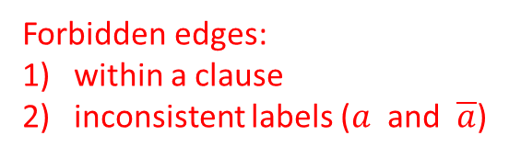










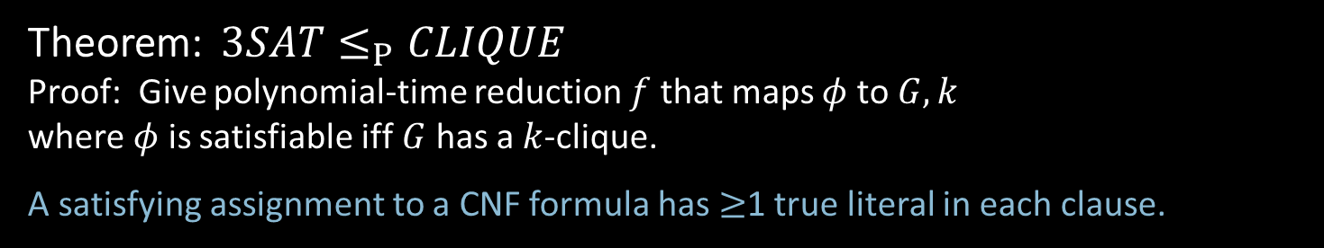



$$3SAT≤_{P}CLIQUE$$
Theorem: $3SAT≤_{P}CLIQUE$
Proof: Give polynomial-time reduction $f$ that maps $φ$ to $G,k$
where $φ$ is satisfiable iff $G$ has a $k$-clique.
A satisfying assignment to a CNF formula has $≥$1 true literal in each clause.
$φ = \left(a∨b∨\overline{c}\right) ∧ \left(\overline{a}∨b∨d\right) ∧ \left(a∨c∨\overline{e}\right) ∧ ⋯ ∧ \left(\overline{x}∨y∨\overline{z}\right)$
$$f$$
$$a$$
$$\overline{c}$$
$$\overline{a}$$
$$d$$
$$a$$
$$\overline{e}$$
$$\overline{x}$$
$$\overline{z}$$
$$G$$
$$k$$
$$=$$
. . .
$$b$$
$$b$$
$$c$$
$$y$$
$=$ # clauses
Forbidden edges:
within a clause
inconsistent labels ($a$ and $\overline{a}$)
$G$ has all non-forbidden edges

Slide 5


















$3SAT≤_{P}CLIQUE$ conclusion
$φ = \left(a∨b∨\overline{c}\right) ∧ \left(\overline{a}∨b∨d\right) ∧ \left(a∨c∨\overline{e}\right) ∧ ⋯ ∧ \left(\overline{x}∨y∨\overline{z}\right)$
$$f$$
$$a$$
$$\overline{c}$$
$$\overline{a}$$
$$d$$
$$a$$
$$\overline{e}$$
$$\overline{x}$$
$$\overline{z}$$
$$G$$
$$k$$
. . .
$$=$$
$$b$$
$$b$$
$$c$$
$$y$$
$=$ # clauses
Check-in 15.1
Does this proof require 3 literals per clause?
Yes, to prove the claim.
Yes, to show it is in poly time.
No, it works for any size clauses.
Claim: $φ$is satisfiable iff $G$ has a $k$-clique
($→$) Take any satisfying assignment to $φ$. Pick 1 true literal in each clause.
The corresponding nodes in G are a $k$-clique because they don’t have forbidden edges.
($←$) Take any $k$-clique in $G$. It must have 1 node in each clause.
Set each corresponding literal True. That gives a satisfying assignment to $φ$.
The reduction $f$ is computable in polynomial time.
Corollary: $CLIQUE∈P → 3SAT∈P$
Check-in 15.1

Slide 6


Slide 7


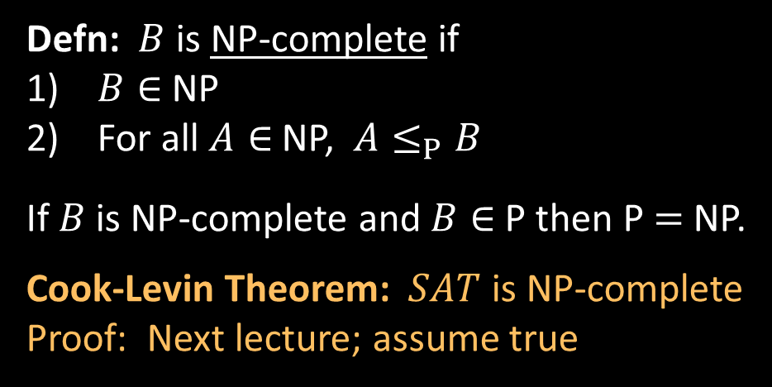



NP-completeness
Defn: $B$ is NP-complete if
$B∈$NP
For all $A∈$NP, $A≤_{P}B$
If $B$ is NP-complete and $B∈$P then P $=$ NP.
Cook-Levin Theorem: $SAT$ is NP-complete
Proof: Next lecture; assume true
next lecture
NP
$$≤_{P}SAT≤_{P}3SAT≤_{P}CLIQUE$$
today
$$≤_{P}HAMPATH$$
To show some language $C$ is NP-complete,
show $3SAT≤_{P}C$.
Check-in 15.2
What language that we’ve previously seen is most analogous to $SAT$?
$A_{\text{TM}}$
$E_{\text{TM}}$
$\left\{0^{k}1^{k}\right| k≥0\}$
or some other previously shown
NP-complete language
Importance of NP-completeness
1) Showing $B$ is NP-complete is evidence of computational intractability.
2) Gives a good candidate for proving P $≠$ NP.
Check-in 15.2

Slide 8







$HAMPATH$ is NP-complete
Theorem: $HAMPATH$ is NP-complete
Proof: Show $3SAT≤_{P}HAMPATH$ (assumes $3SAT$ is NP-complete)
Idea: “Simulate” variables and clauses with “gadgets”
$φ = \left(x_{1}∨{\overline{x}}_{2}∨x_{3}\right) ∧ \left({\overline{x}}_{1}∨x_{2}∨x_{4}\right) ∧ ⋯ ∧ \left( \right)$
$$f$$
$$s$$
$$〈G,s,t〉$$
$$x_{1}$$
. . .
clause gadget
variable gadget
Zig-zag
Corresponds to setting $x_{1}$ True
Zag-zig
Corresponds to setting $x_{1}$ False

Slide 9


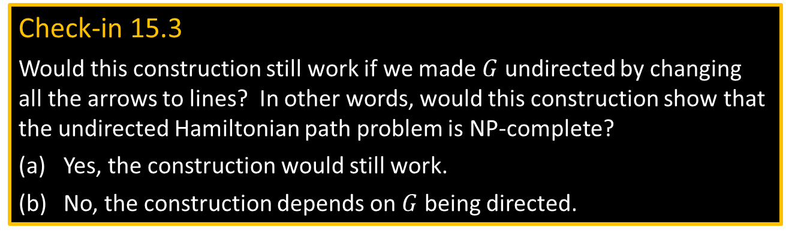

















Construction of $G$
$φ = \left(x_{1}∨{\overline{x}}_{2}∨x_{3}\right) ∧ \left({\overline{x}}_{1}∨x_{2}∨x_{4}\right) ∧ ⋯ ∧ \left( x_{m} \right)$
$$c_{1}$$
$$c_{2}$$
$$c_{k}$$
$m$ variables
$k$ clauses
$$G$$
$$s$$
$$c_{1}$$
$x_{1}$ positive in $c_{1}$
$$x_{1}$$
. . .
. . .
$$c_{2}$$
$x_{2}$ negated in $c_{1}$
$x_{1}$ negated in $c_{2}$
$$x_{2}$$
. . .
The reduction $f$ is computable in polynomial time.
. . .
. . .
$$c_{k}$$
Check-in 15.3
Would this construction still work if we made $G$ undirected by changing
all the arrows to lines? In other words, would this construction show that the undirected Hamiltonian path problem is NP-complete?
Yes, the construction would still work.
No, the construction depends on $G$ being directed.
Claim: $φ$is satisfiable iff $G$ has a Hamiltonian path from $s$ to $t$.
($→$) Take any satisfying assignment to $φ$.
Make corresponding zig-zags and zag-zigs through variable gadgets from $s$ to $t$.
Make detours to visit the clause nodes $c_{i}$.
($←$) Take any Hamiltonian path from $s$ to $t$.
Show it must be zig-zags and zag-zigs with detours to visit all $c_{i}$.
Get corresponding truth asst. It must satisfy $φ$because path visits all $c_{i}$.
. . .
$$x_{m}$$
. . .
$$t$$
Check-in 15.3

Slide 10
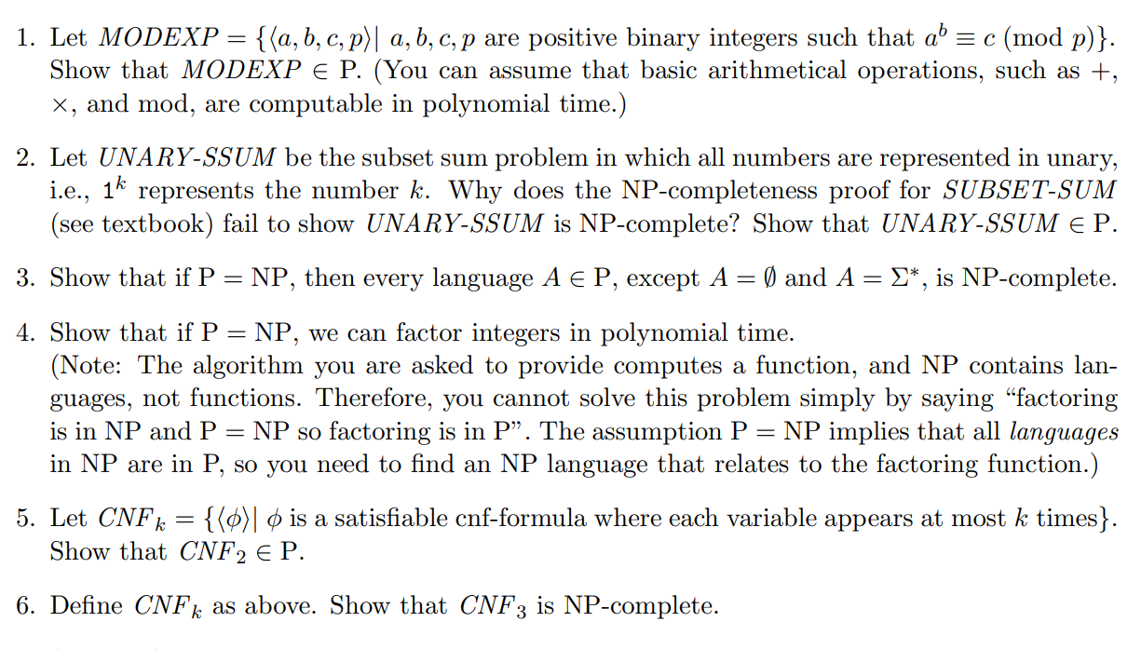
Problem Set 4

Slide 11

Quick review of today
NP-completeness
$SAT$ and $3SAT$
$3SAT≤_{P}HAMPATH$
$3SAT≤_{P}CLIQUE$
Strategy for proving NP-completeness: Reduce from $3SAT$ by constructing gadgets that simulate variables and clauses.

